Slide 1
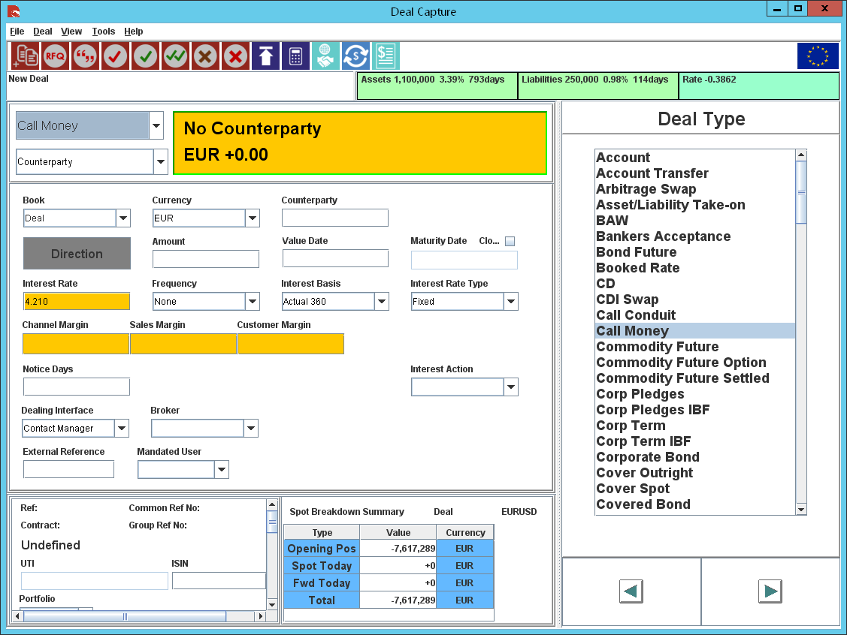
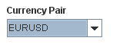
Minimum Rate
Minimum Rate
Maximum Rate
Enhanced Rate
Early Termination?
This field value should be defaulted to “UnTicked” and be disabled.
Default to Min Rate (can be overridden)
Allow 3rd Party Payments

